Slide 1
Review of Old Question Paper (EC3-R S2-22-23)

Slide 2
Q1
In no particular sequence, these are some of the advantages of waterfall and agile techniques. The description hints at the methodology being discussed. Choose the best approach (waterfall or agile) for each advantage. [
Then, what are the drawbacks of each advantage?
1. Short deadlines promote productivity and efficiency.
2. The methodology is client-facing, or the customer is a member of the team, which implies that the team communicates progress and includes consumer feedback into the process.
3. Provides a detailed project plan from conception to conclusion.
4.There is a lot of leeway in changing project directions and experimenting with new ones.
5.Early on in the project, the team defines project requirements, which can save time.
6. Each phase of the project requires a deliverable to progress to the next phase, making the workflow more structured

Slide 3
Q1-Answer
1. Short deadlines promote productivity and efficiency.
##Agile: Because team members are working on multiple phases at a time, there is potential for overlap or unnecessary effort spent on later stages if an early phase needs to be modified
2. The methodology is client-facing, or the customer is a member of the team, which implies that the team communicates progress and includes consumer feedback into the process.
##Agile: The project timeline is more difficult to determine from the start, and it is also more susceptible to change
3. Provides a detailed project plan from conception to conclusion.
##WF: Because each project phase needs to be completed before progressing to the next stage, the process can take longer
4.There is a lot of leeway in changing project directions and experimenting with new ones.
##Agile: Deliverables are not a requirement to progress to the following phase. It can be harder to ensure the entire team is on the same page—especially if it’s a large team with different departments. It also means that work can get lost or miscommunicated between team members, especially when people leave and join the team in the middle of the projects.
5.Early on in the project, the team defines project requirements, which can save time.
##WF:You might not realize an issue with a phase until you have already progressed to the next one. This would mean going back through each phase and checking where the mistake or error occurred, which can be a timely process.
6. Each phase of the project requires a deliverable to progress to the next phase, making the workflow more structured
##WF:The Waterfall methodology requires that you outline the project from start to finish before you begin. This doesn't allow for a lot of flexibility or change. Additionally, it can become problematic if the stakeholders disagree on the project’s vision and don’t find out until it is executed or in a later phase.

Slide 4
Q2-
Given the following high-level project description, which of the following projects is most suited to the adaptive technique and which to the predictive
method?
1. A medical diagnostics app that requires frequent user feedback to fine-tune the app.
2. Projects requiring a high level of oversight and/or accountability, such as those in banking, healthcare, and nuclear facility control systems.
3. Money and time are secondary considerations; what matters most is the project's safety and stability.
4. A project that necessitates regular progress updates with business owners and stakeholders.
5. A project owner has a clear and specific vision for an app that he or she is confident will not change during the project's development.
6. A project with a fixed (Time, Cost, Scope) bid and a team of four people developing a mobile app
7.A project with deliverables that change frequently, such as technology products.
8. A project that evolves or does not begin with a clear scope and requirements
9. A project emphasizes process and product improvement and requires a method for continuous progress.
10.A project must adhere to strict guidelines because each phase requires deliverables before moving on to the next.
11. A project that is experimenting with direction and has no idea how the final project will look before it begins.
12 A distributed team developing medically regulated hardware.

Slide 5
Q2- Answer (1)
1. A medical diagnostics app that requires frequent user feedback to fine-tune the app. –Agile
2. Projects requiring a high level of oversight and/or accountability, such as those in banking, healthcare, and nuclear facility control systems.- WF
3. Money and time are secondary considerations; what matters most is the project's safety and stability.-WF
4. A project that necessitates regular progress updates with business owners and stakeholders.-Agile
5. A project owner has a clear and specific vision for an app that he or she is confident will not change during the project’s
development. –WF
6.A project with a fixed (Time, Cost, Scope) bid and a team of four people developing a mobile app -Agile/WF

Slide 6
Q2-Answer(2)
7.A project with deliverables that change frequently, such as technology products. Agile
8. A project that evolves or does not begin with a clear scope and requirements – Agile
9. A project emphasises process and product improvement and requires a method for continuous progress. –Agile
10.A project must adhere to strict guidelines because each phase requires deliverables before moving on to the next.-WF
11. A project that is experimenting with direction and has no idea how the final project will look before it begins.-Agile
12 A distributed team developing medically regulated hardware.-WF

Slide 7
Q3
Assume you are a real estate developer building a 100-unit housing project. Consider each house to be a "feature" (a smallest unit high fidelity delivery), and "releasing a feature" refers to its release to the client. In terms of house delivery, how would each of the agile, iterative, incremental, and predictive techniques relate to home sales? Which techniques are likely to succeed? What methods do real estate developers use?

Slide 8
Q3-Answer
Waterfall and Incremental method works.
Generally , phase by phase completion: Main housing, Common area …..
Real estate developer may prefer Agile.

Slide 9
Q4
Which of the following descriptions best describes a project?
Building a new house
Developing a new software application
Performing an assessment of current manufacturing processes
Improving an organizational business process
Writing a book
Relocating a company’s technology infrastructure to a new location or to a cloud platform
Merging two organizations
Developing a new medical device.
Performing accounts receivable and accounts payable activities
Executing daily manufacturing orders
Performing recommended equipment maintenance procedures
Conducting customer account maintenance

Slide 10
Q4-Answer
Which of the following descriptions best describes a project?
Building a new house (P)
Developing a new software application (P)
Performing an assessment of current manufacturing processes
Improving an organizational business process
Writing a book (P)
Relocating a company’s technology infrastructure to a new location or to a cloud platform
Merging two organizations (P)
Developing a new medical device. (8)
Performing accounts receivable and accounts payable activities
Executing daily manufacturing orders
Performing recommended equipment maintenance procedures
Conducting customer account maintenance

Slide 11
Q5
A self-organizing Agile Team has the ability to choose how it accomplishes its work. In practice, how does this team behavior present itself in a variety of ways during a sprint? Make a list of at least six ways.

Slide 12
Q5- Answer
Scrum Teams take ownership of their processes..
Scrum Teams determine a Sprint Goal together.
Development Team members don’t wait until the Daily Scrum to bring up challenges or impediments.
Development Team members decide how and when to swarm problems that jeopardize the Sprint Goal.
Development Team members update their Sprint Backlog to reflect current progress and new learning.
Scrum Team members address and resolve their own disagreements and conflicts.
Scrum Teams make consensus-based decisions in a timely manner. They determine if they need to consult outside expertise.

Slide 13
Q6
1."Working Software Is the Primary Measure of Progress," says one Agile principle. Why is it difficult and problematic to measure progress on a software development project using the Waterfall method? How does the Agile method attempt to address this?
2. Product backlog grooming is an important stage in the Scrum process that is not reflected directly in the Scrum framework diagram. Who are the meeting's attendees, and mention at least four meeting outcomes?

Slide 14
Q6-Answer
Waterfall
Backlog grooming, -PO, SM, Dev team, Other Stakeholders if required

Slide 15
Q7
Which of these situations illustrates using Agile principles and which illustrates using Agile practices? Justify and explain your response.?
1. The team is aware that having a face-to-face discussion with her team is the most efficient way to convey crucial information about the project.
2. The team use incremental design to ensure that the code they create is simple because they are aware that users may change their minds in the future and that these changes may have a negative impact on their code.
3. Because the team is aware that they will build software more effectively if they have a better understanding of the users, The team uses a persona to represent a typical user.
4. Since working software is the best way to demonstrate the team's progress to stakeholders, the team always makes sure that they are working on something that they can show them.
5. The team wants to improve the way the team builds software by getting everyone to improve collaboratively and evolve experimentally by coming up with changes to their process that they can all make together and using data to see if those changes made things better.
6. The team embraces change by writing code that is simple to modify in the future.

Slide 16
Q7-Answer (1)
1. The team is aware that having a face-to-face discussion with her team is the most efficient way to convey crucial information about the project.
>>1. Principle:This is one of the principles behind agile: that a face-to-face conversation is the most effective way to convey information to and within a software team.
2. The team use incremental design to ensure that the code they create is simple because they are aware that users may change their minds in the future and that these changes may have a negative impact on their code.
>>Practice: Incremental design is an XP practice in which the team grows the codebase incrementally. over time.
3. Because the team is aware that they will build software more effectively if they have a better understanding of the users, The team uses a persona to represent a typical user.
>>Practice:A persona is a practice in which the team creates an fictional user with a name (and often a fake photo) to better understand who will be using their software.
.

Slide 17
Q7-Answer(2)
4. Since working software is the best way to demonstrate the team's progress to stakeholders, the team always makes sure that they are working on something that they can show them.
>>Principle:An important agile principle is that working software Practice is the primary measure of progress in the project, because it's the most effective way for everyone togauge exactly what the team has accomplished.
5. The team wants to improve the way the team builds software by getting everyone to improve collaboratively and evolve experimentally by coming up with changes to their process that they can all make together and using data to see if those changes made things better.
>>Practice:This is one of the core practices of Kanban. The team uses the scientific method to see if their improvements actually work in practice.
6. The team embraces change by writing code that is simple to modify in the future.
>>Principle:Principle An important value shared by all effective XP teams is that embrace change, rather than try to prevent or resist it.

Slide 18
Q8
1. Assuming one-week iterations and a team of four developers, how many iterations will it take the team to complete a project with 27 story points if they have a velocity of 4? A story estimated at one story point actually took two days to complete. How much does it contribute to velocity when calculated at the end of the iteration?
2. These are a few examples of agile principles, practices, and concepts. Which of these are derived from Scrum, XP, and Lean, and what traits do Scrum, XP, and Lean share in common?
1. Commitment, 2. Eliminate Waste, 3. Deliver as Fast as Possible, 4. Last Responsible Moment 5. Openness, 6. Courage, 7. Simplicity, 8. Respect, 9. Empower the Team (Whole Team) 10. Amplify Learning (Feedback, Iterations), 11. Energized Work (Focus) 12. Build Integrity In, 13. See the Whole

Slide 19
Q8-Answer(1)
1- Story point

Slide 20
Q8-Answer(2)
Lean: Eliminate Waste, Deliver as Fast as Possible, Build Integrity In, See the Whole
XP: Simplicity, Energized Work
Scrum: Commitment (Value)
XP ,SCRUM & Lean: Amplify Learning (Feedback, Iterations),Last Responsible Moment
Lean &XP: Empower the team(Whole team)
Lean & Scrum:Openness
Scrum & XP: Respect , Courage

Slide 21
Q9
Teams utilize the ‘5-Whys’ technique to uncover the root cause of a problem by asking a series of 'why' questions. Consider a scenario in which the production site is unavailable for two days, causing significant disruption. Create a list of 5 'Why' questions and a pertinent response for each question to find the cause of the issue.

Slide 22
Q9-Answer
1. Why did the incident happen? -Response Our application database went down.
2. Why did the database go down? -The file system became full and there was no disk space left.
3. Why did the support team not monitor the disk usage levels proactively?-They are new to the team and do not have enough knowledge of the diagnostic tools and how to deal with the system generated alerts.
4. Why did the new support team members not have enough knowledge?- The knowledge transition has not fully happened. Our team memberslack the experience in using the diagnostic tools.
5. Why has the knowledge transition not happened? - We have been so busy with issues daily, that we couldn’t prioritize the training sessions. But we should do that as soon as possible, otherwise we will have more issues like this.

Slide 23
Q10
Agile teams invest in a variety of ways in order to spread knowledge among themselves. List and briefly describe at least 12 different occasions in which Agile teams share expertise with their peers. ?

Slide 24
Q10-Answer
Tacit knowledge build-up as team members sit together. • Advanced communication tools and technologies to connect distributed teams.
• Using forums for collaboration like brainstorming, group decision-making for planning, estimation, problem solving. and risk mitigation.
• Iteration demos to share knowledge between stakeholders on what the team achieved during an iteration.
• Wireframes, personas and prototypes to arrive at a blueprint of what the system should look like at the end.
• Retrospectives to determine ways to improve the way of working.
• Information radiators to share project metrics and progress with stakeholders.
• Daily stand-up meetings where team members share their progress and impediments so that everyone is aware what everyone is doing.
• Swarming around a problem by gathering around it, diagnosing. and resolving it as a team.
• Expert in earshot where junior and new team members gather knowledge about the project and the product by sitting close to more senior and experienced team members.
• Pair programming and pair rotation so that knowledge of the system implementation is shared between multiple team members, leading to collective ownership of code.
• Continuous build, integration, automated and exploratory testing to provide realtime feedback on the code.
• Investing behind training and upskilling the team (refer to the Dreyfus Model.
• Conducting spikes to gain knowledge on unfamiliar technologies.

Slide 25
Q11
1. Answer the following questions: [4]
1. At which phase of the Agile project is Risk planning done?
2.Product parts are often subject to damage during shipment, which causes a high level of impact on the customer. To manage the risk, the project team insures all shipments. This risk response is a good example of:
3.Errors missed by quality assurance and control process and released to the end user are:
4.An approach where testers perform minimum test planning and maximum test execution is known as:
5. Frequently integrating new and changed code is known as:
6. During a problem detection session, you ask WHY five times because:
7. The formula for risk severity is:
8.Steps to perform while using TDD technique:
2. Assume you are creating a library management system. You intend to conduct exploratory testing. Create four exploratory test scenarios that you might. want to run.

Slide 26
Q16-Answer

Slide 27
Q11- Answer(1)
1.During the entire project lifecycle
2. Risk Transfer/Share
3. Escape defects
4. exploratory testing
5. Continuous Integration
6.To get to the root cause of an issue
7. Probability* Impact
8.write test, write code, refactor
Browser back button, 2. Refresh button, 3. Power off, 4.

Slide 28
Q12
Q1. A few examples of situational issues are provided below. In each situation, what is your best course of action? [3]
1. Your team committed to delivering 20story points this iteration, but it looks like you will only complete 14. You should:
2. You are leading a team with an average velocity of 85 points per iteration. Another team of the same size in your organization is working on a different project with similar complexity. The other team’s velocity is averaging 125 points per month. Your team should:
3. During a planning poker session, participants come up with estimates of 5, 8, 13, 38, 5 and 5 respectively during the first round for a particular story. What should the facilitator advise?
Q2. Create three acceptance criteria for the user story below. Each criterion should have a yes/no or pass/fail response. [3]
As a library user, I want to check the availability of a novel and reserve it, so that I can read it during my leisure time.

Slide 29
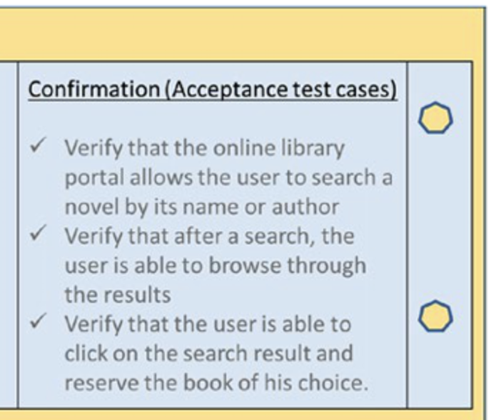
Q12-Answer(1)
1. An iteration is timeboxed. Unfinished work is returned back to the backlog.
2. Velocity is team specific- dont compare
3. It is common to see variability in estimates at the beginning of the estimation session, so it’s advisable to play a few rounds for consensus to emerge.

Slide 30
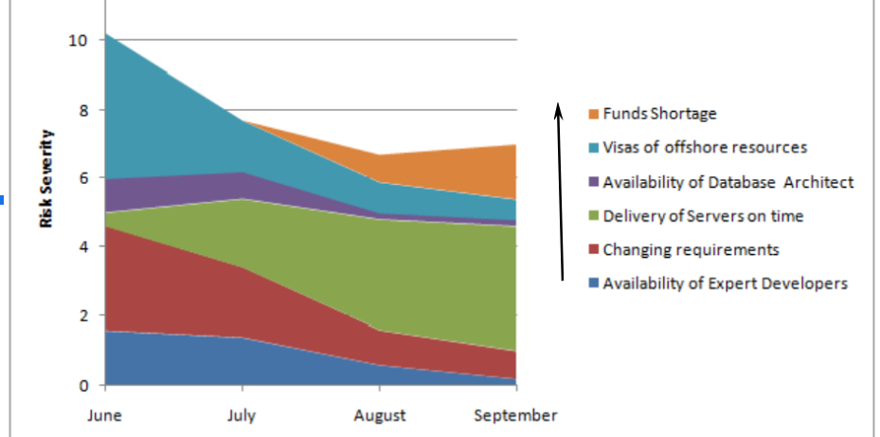
Q13
What exactly is this graph and what does it serve? What can you learn or identify issues from this graph, and what are the likely causes?
How long is the Agile feedback cycle, which includes continuous integration, pair programming, unit testing, sprint reviews, in-person customer interaction, and release?

Slide 31
Q13-Answer
The risk burndown graph demonstrates how risk hazards decrease over time and also shows the severity of risks.
1. Funds Shortage increases as the project progresses. Hence Severity of this risk becomes more
2. The risk severity of Visas of Offshore Resources not getting processed on time decreases as the time progresses
3. The Risk Severity of Availability of Database Architect goes down over time
4.The risk “Delivery of Servers on Time” increases over time since the hardware vendor delays the delivery of Servers. As Project project progresses, if the vendor delays further then the severity becomes very high.
5. Risk of Changing Requirements goes down over time since customer gets clarity on requirement. Hence the risk severity also goes down
6. As the projects progresses, the risk of Availability of Expert Developers goes down and hence severity also goes down.
5.2
B. 10-15 mts, Immediate, 10-15mts, weeks, Immediate, months.

Slide 32
Q14
Q1.What kind of risk response strategy does a Spike story provide? How does the spike's outcome benefit the team in various ways? Make a list of at least four outcomes.
Q2. The product features are divided into four categories. Which features will you prioritize delivering first, second, and third? Which features should you avoid delivering? [2]
1. Low Risk, High Value features.
2. Low Risk, Low value features
3. High Risk, High value features
4. High Risk, Low value features.

Slide 33
Q14-Answer
Q1
1. Mitigate risks with uncertain technologies or domain
2. make better quality of estimates that can stand ground amid uncertainties
3. check feasibility of architecture or design options
4.help the team fail-fast. If the experiment is unsuccessful, it implies that the project that would have been based on the same assumption or solution would have failed as well, incurring wastage of time, effort and money. Based on the outcome of the risk-based spike, the project team thus becomes wise in choosing alternative options to invest resources.
5. ascertain worthiness of the investment
Q2
Deliver: 3,1,2
Avoid -4

Slide 34
Q15
What risk response strategy are you employing in the following scenarios? [
1. Investigate contracting options if skilled resources are unavailable.
2. Educate the resources on the new skills.
3. Using open-source software and reducing reliance on vendor software
4. Restoring the previous version of the web portal because the upgraded user registration process is inconvenient.
5, Continue to cross-train the team and look for replacements due to high attrition.
6. Investment behind redundant storage disks and backup infrastructure
7. Outsourcing of work to a third-party service provider using a fixed price contract
8. Project that is on the verge of missing its deadline, extending the deadline or reducing the scope of the project

Slide 35
Q15-Answer
1. Investigate contracting options if skilled resources are unavailable.- Distribute/Transfer
2. Educate the resources on the new skills. Mitigate
3. Using open source software and reducing reliance on vendor software- Avoid
4. Restoring the previous version of the web portal because the upgraded user registration process is inconvenient. - Accept
5, Continue to cross-train the team and look for replacements due to high attrition. - Mitigate/accept
6. Investment behind redundant storage disks and backup infrastructure. - Mitigate
7. Outsourcing of work to a third-party service provider using a fixed price contract-Transfer
8.Project that is on the verge of missing its deadline,r extending the deadline or reducing the scope of the project-Avoid

Slide 36
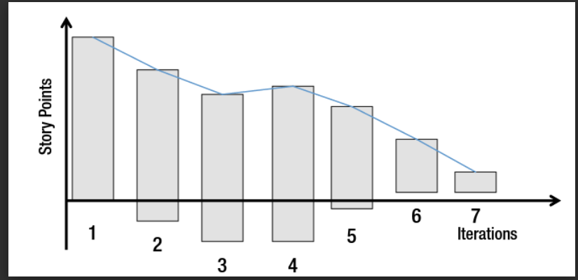
Q16-
Explain the release burndown chart below, from Iteration 1 to Iteration 7.How do you interpret each bar graph, line graph, and iteration's scope?

Slide 37
Q16- Answer
Iteration-2 Bar graph lowered; Story points/Work added
Iteration -6 Bar graph raised; Story points/work removed
Velocity gradient

Slide 38
Q17
In various projects, you have encountered the following situations. Based on these parameters, you must select a Sprint length of 2 weeks or 6 weeks. What is your preferred sprint length for each situation, and why do you like it that way?
1. Releases are more frequent
2. There is high overhead in iterating
3. Priorities and requirements do not change very often
4. You have strong need to maintain focus and sense of urgency

Slide 39
Q17-Answer
1. 2 weeks
2.4- 6 weeks
3.4- 6 weeks
4. 2 weeks

Slide 40
Q18
Q1.Assume you've been tasked with developing library management systems. Create a product roadmap that spans four quarters.
Q2. The just-in-time (JIT) planning approach is used by agile methodologies. Provide three examples of Agile practices that use JIT planning.

Slide 41
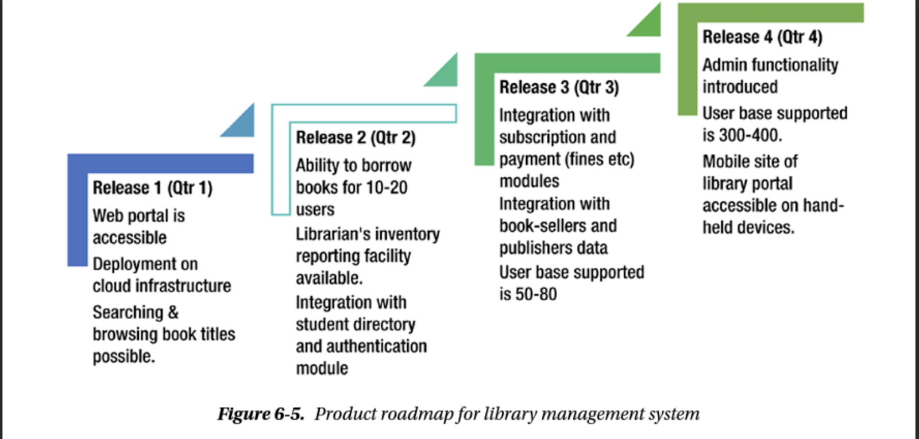
Q18-Answer (1)

Slide 42
Q18-Answer(2)
As we have seen before, Kanban pulls items from the backlog only when capacity becomes available, thereby reducing work items from being queued up in the ‘work-in-progress’ state.
Coming to Scrum or XP, we observe that detailed planning only happens for the current iteration and anything outside it is left at a high level (in the backlog or the release plan) to be adapted based on change of requirements or priorities.
Similarly, the user stories are elaborated and estimated just-in-time, architecture, design and coding also happens just when it is necessary. This prevents any elements of rework or aspects of design and code that are not required by the customer.

Slide 43
Q19
Q1.MoSCoW is a requirement management prioritization technique. This abbreviation stands for "Must have (Mo), Should have (S), Could have (Co), and Won't have (W)." The requirements for a familiar object or thing that we use every day are listed below. Using the MoScoW technique, prioritize the following requirements.
1. A mobile phone is to be able to play music, click photos, or help with GPS navigation.
2. A mobile phone is the ability to make and receive calls and an address book to store the list of contacts.
3. A mobile phone is the ability to connect to a data network and being able to browse the Internet.
4. A mobile phone could be used to act as a pedometer that counts steps for a morning jogger.
5. Being able to toggle the channel or volume buttons on a TV remote
6. Being able to search for a book from our library management system.

Slide 44
Q19-Answer
A mobile phone is to be able to play music, click photos, or help in GPS navigation.
>>Could have
2. A mobile phone is the ability to make and receive calls and an address book to store the list of contacts.
>> Must have
3. A mobile phone is the ability to connect to a data network and being able to browse the Internet.
>>Should Hvae
4. A mobile phone could be to act as pedometer that counts steps for a morning jogger
>>Won't have
5. Being able to toggle the channel or volume buttons on a TV remote
>>Must have
6. Being able to search a book from our library management system.
>> Must have

Slide 45
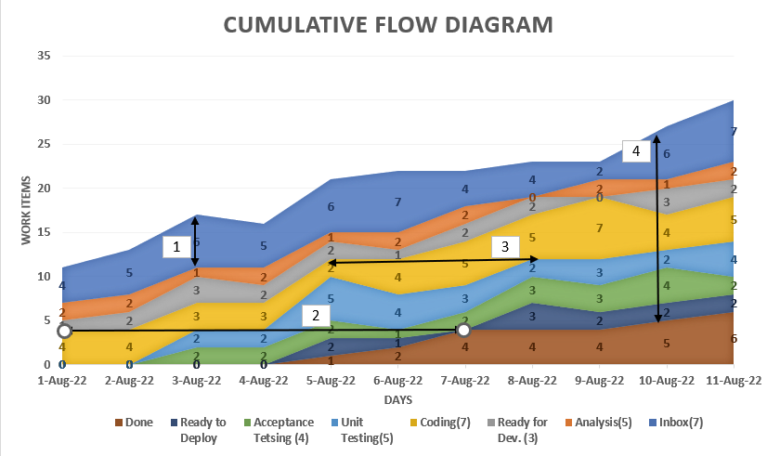
Q2.Q19

Slide 46
Q2.-Q19
1. Length of the InBox Queue on Aug 3
2. Leadtime
3. Cycle time of Coding
4. Total WIP on 10th Aug
Observe Bottlenecks

Slide 47
Q21
Q1.What exactly is 'Technical Debt'? Agile teams understand the importance of striking a balance between feature development and reducing the complexities caused by technical debt. Which practices will aid in the reduction of 'Technical debt'? [3]
Q2. "Businesspeople and developers must work together daily throughout the project," according to one of the Agile principles. However, the Agile team faced the following challenges. How does the Agile team plan to overcome them?
Communication challenges:
The Agile team and business may not be co-located. This is a realistic problem where:
A software is being built to serve multiple lines of business, often at various geographical locations.
The software has many components that are being codeveloped by developers based out of multiple locations, often in different time zones.
The business people might have limited availability and their 'daily' meeting commitment may not be fulfilled.

Slide 48
Q21-Answer
Q1. Refactoring, Code review, Testing tools, Automated Testing

Slide 49
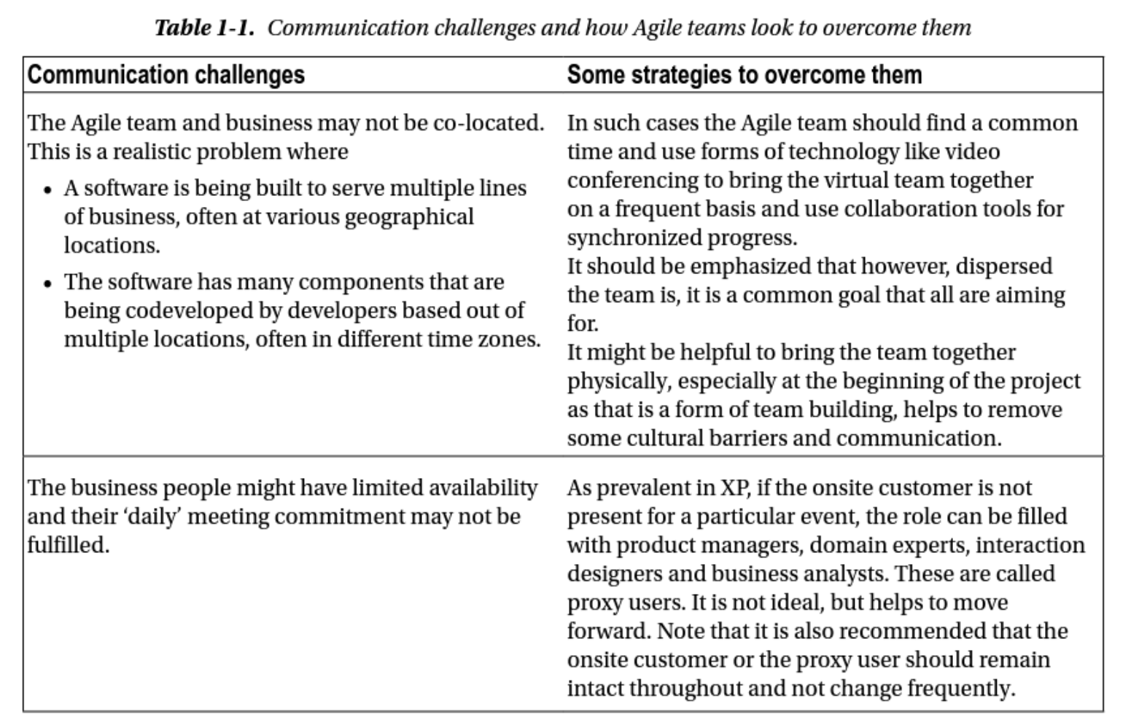
Q21-Answer(2)

Slide 50
Q22
Q1The daily standup meeting is usually limited to three questions that each team member must answer. Taking this goal into account, which of the following are valid and incorrect topics discussed during daily standup meetings, and why?
1. Our new contractor can’t start because no one is here to sign the contract.
2. The department manager has asked me to work for another team for the remaining week.
3. I tested story number 10 yesterday.
4. I’m struggling to learn C++ and would like to pair with someone on it.
5. I can’t get the product owner to show up or call me back.
6. You explain why a team member should be removed from the team.

Slide 51
Q22-Answer
Valid- Impediment, 2. Valid- Impediment, 3. Valid-Progress, 4. Valid- Impediment; 5. Valid- Impediment, 6. Invalid-

Slide 52
Q23
Give an example for at least one measure that you would define, if you were a customer, a team member, or a management member. For each measure define its purpose and how it would help you improve performance. Describe specific scenarios in which these measures would be helpful.

Slide 53
Q23-Answer
The development team is interested in measuring the impacts of the development methodology, the satisfaction of the people involved,
Customer: and the quality of the artifacts from technical perspectives, such as maintainability and extensibility;
Management people are interested in business aspects, like project costs and return on investment, as well as customer satisfaction.

Slide 54
Q24
Suggest examples of measures that should be taken several times a day, on a daily basis, and on an iteration basis. Specify the purpose of each measure.

Slide 55
Q24-Answer
Number code Check In , Automated test passed- should be taken several time a day
Amount of effort spent by team members - taken daily basis
Number of story points completed - Iteration basis

